Slide 1
Multievent model:
A statistical tool for animal epidemiology

Slide 2
Disease cycle
H
I
3 States
H: Healthy
I: Ill
†: Dead
†

Slide 3
4 Events
Events:
  0: not seen
  1: captured healthy
  2: captured ill
  3: health status is unknown (i.e. seen at distance)

Slide 4
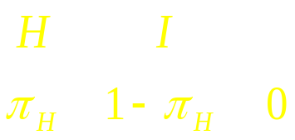
Initial state probabilities
Be careful!
The initial state probabilities
are not prevalence rates !
†
t

Slide 5
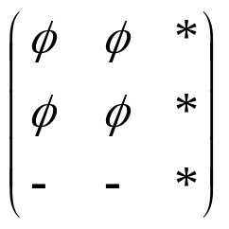
State process
Survival-transition probabilities:
H
I
†
H
φ
φ
1
−
φ
−
φ
H
H
H
I
H
H
H
I
I
φ
φ
1−
φ
I
H
I
I
I
I
†
0
0
1
t

Slide 6
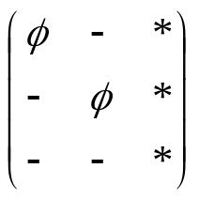
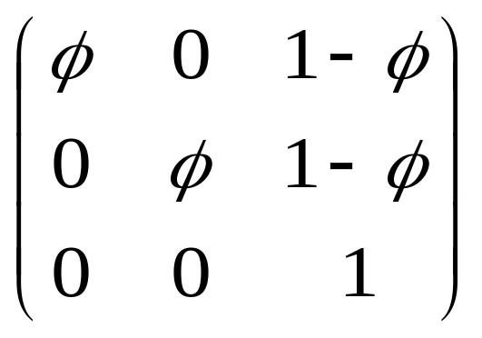
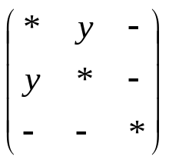
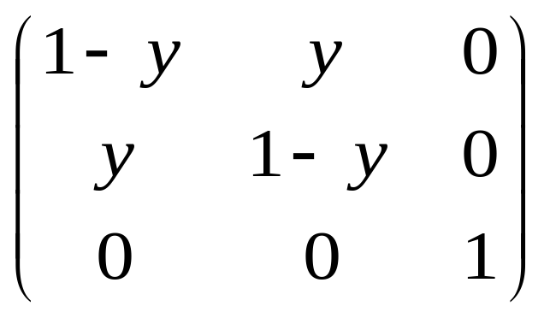
Two-step transitions
H I †
Step 1: Survival
H I †
Step 2: Disease course

Slide 7
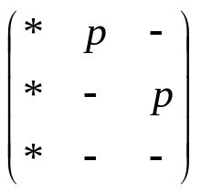
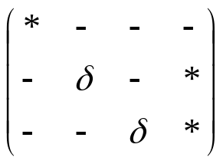
Event process
Step 1: encounter
NE_{C} E_{H} E_{I}
H 1-p p 0
I 1-p 0 p
† 1 0 0
Step 2: health assessment
0 1 2 3
NE_{C} 1 0 0 0
E_{H} 0 d 0 1-d
E_{I} 0 0 d 1-d

Slide 8
What about:
False positive?
False negative?
A disease without possibility of healing?

Slide 9
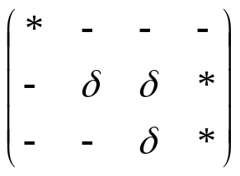
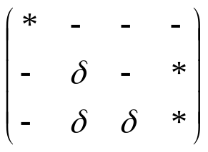
Event process
Step 2: health assessment
False positive
0 1 2 3
NE_{C} 1 0 0 0
E_{H} 0 e f 1-e-f
E_{I} 0 0 d 1-d
False negative
0 1 2 3
NE_{C} 1 0 0 0
E_{H} 0 d 0 1-d
E_{I} 0 e f 1-e-f

Slide 10
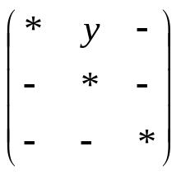
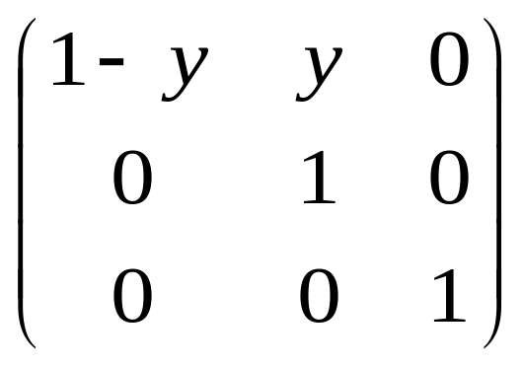
State process
Step 2: Disease course
H I †
Incurable ill

